Slide 1
Decarbonization & Electrification for Applied HVAC Systems
Industry Guidance on Thermal Systems
Presented by: Jeff Seewald, HVAC Systems Business Development Manager
May 14, 2025
DISCLAIMER: This presentation is intended only for educational purposes and does not replace independent professional judgment and/or legal advice.
This presentation is copyrighted and cannot be used without the express permission of Daikin Applied Americas Inc.
Notes:
Revision A

Slide 2




Introductions
Jeffrey Seewald, PE, CEM
HVAC Systems Business Development Manager
jeffrey.seewald@daikinapplied.com
Joined Daikin in November 2023
30 years of experience
  HVAC equipment and systems
  Building automation and controls
  Energy efficiency and infrastructure renewal
Focus areas at Daikin include:
Decarbonization
  Refrigerants
  Electrification and heat pumps
  Energy efficiency
  Indoor air quality

Slide 3

Introductions
Sammy Houssainy, PhD, PE
Energy Modeling Manager
Sammy.Houssainy@DaikinApplied.com
Joined Daikin in June 2024
Previously
  Project Manager at Department of Energy’s National Renewable Energy Lab (NREL)
Focus areas at Daikin include:
  Energy modeling
  Decarbonization
  Electrification

Slide 4
Disclaimer
This content subject to change without notice and is intended only for educational purposes and does not replace independent professional judgment and/or legal advice. The ultimate responsibility is on the engineer of record to ensure the design complies with all applicable codes and Daikin Applied will not accept responsibility or liability for actions that result from the information shared in this presentation. This content is copyrighted and cannot be used without the express permission of Daikin Applied Americas Inc.
Always consult your state & local codes, which may take precedence over standards which vary in adoption, complete or partial, by state. Also note that a state may adopt a different year of the standard than the latest version.
The local Authority Having Jurisdiction (AHJ) has the final authority in interpreting code requirements.

Slide 5
Webinars
Decarbonization Series: Prior & Upcoming Webinars
Part | Date | Title | Description
1 | April 16 | Decarbonization of HVAC Systems - Part 1: Review and Industry Update | In this session, we’ll explore the decarbonization of HVAC systems with a review of the latest industry advancements and essential concepts, followed by discussion of heat pump system application and design considerations, and groundbreaking projects that are shaping the future of electrified and sustainable HVAC systems.
2 | May 14 | Decarbonization of HVAC Systems - Part 2: Industry Guidance on Thermal Systems | A guided tour of Decarbonizing Building Thermal Systems: A How-to Guide for Heat Pump Systems and Beyond. This guide, produced by NREL in conjunction with the US Department of Energy and ASHRAE offers essential guidance as we prepare to decarbonize and electrify buildings.
3 | June 18 | Decarbonization of HVAC Systems - Part 3: Rooftop Unit Heat Pump Systems | “All Things RTU Heat Pump”: The third installment of our three-part webcast series will zoom in on rooftop unit heat pump systems and discuss application and design considerations of this ubiquitous equipment, now available in a versatile and high-performance heat pump form.
Webinar series open to sales representatives and customers!

Slide 6
Review
Refrigerants
Efficiency
Optimization
Heat pumps
Electrification
Low GWP

Slide 7
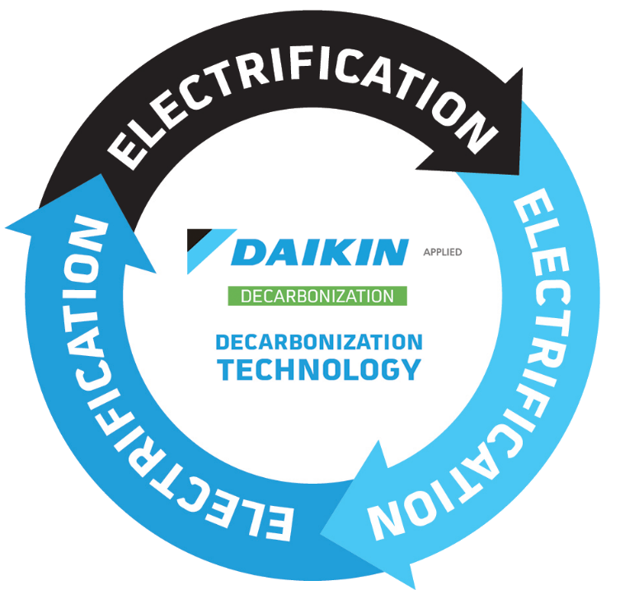
Review
Refrigerants
Efficiency
Optimization
Heat pumps
Electrification
Low GWP

Slide 8
Agenda
Approach
Heat Pumps
Designing & Sizing
Prerequisites
New construction vs retrofit
Selection
Refrigerants
Codes & Standards
Capacity and sizing
Supplemental heat
Installation & Operation
Retrofits
Installation
Operation
System types
Energy storage
What do I need to consider before decarbonizing my building?
What is the role of refrigerants?
What codes and standards apply?
How do I go about selecting a heat pump?
What are potential sources of heat?
What are potential heat recovery opportunities?
How do I assess supplemental heat?
How do I design a heat pump system?
How do I avoid over-sizing heat pumps?
What are the most important retrofit scenarios and considerations?
What about retrofit application scenarios?
What are best practices for installation and operation of heat pump systems?

Slide 9
Registration Questions
What do you presently see as the greatest opportunity(ies) in application and design of heat pump systems?
What do you presently see as the greatest challenges in application and design of heat pump systems?
Air-source heat pumps (ASHPs)
Water-based (hydronic) systems
Split systems with VAV AHUs
Cascade systems
Hospitals, schools, office
Energy efficiency and carbon reduction
Elimination of inefficient boilers
Lack of space for large heat pumps and buffer tanks
Inadequate electrical infrastructure, grid and building
Electrical upgrade costs
Increased electrical demand
Cost of geothermal bore fields
Low ambient performance
Defrost control
Hot water delivery temperature
Price and cost
Proper implementation
“Old school thinking”
Today’s webinar features 4 audience polls
©2025 Daikin Applied

Slide 10

Registration Questions
What questions do you have about applying rooftop unit heat pumps?
We Value Your Feedback!
We welcome your feedback on this webinar and the series:
  Please complete the survey – link in the chat, or use the QR code below
  Provide additional comments in the chat
Backup / supplemental heat
Defrost
Cold climate applications / low ambient operation
First cost and life-cycle cost analysis

Slide 11
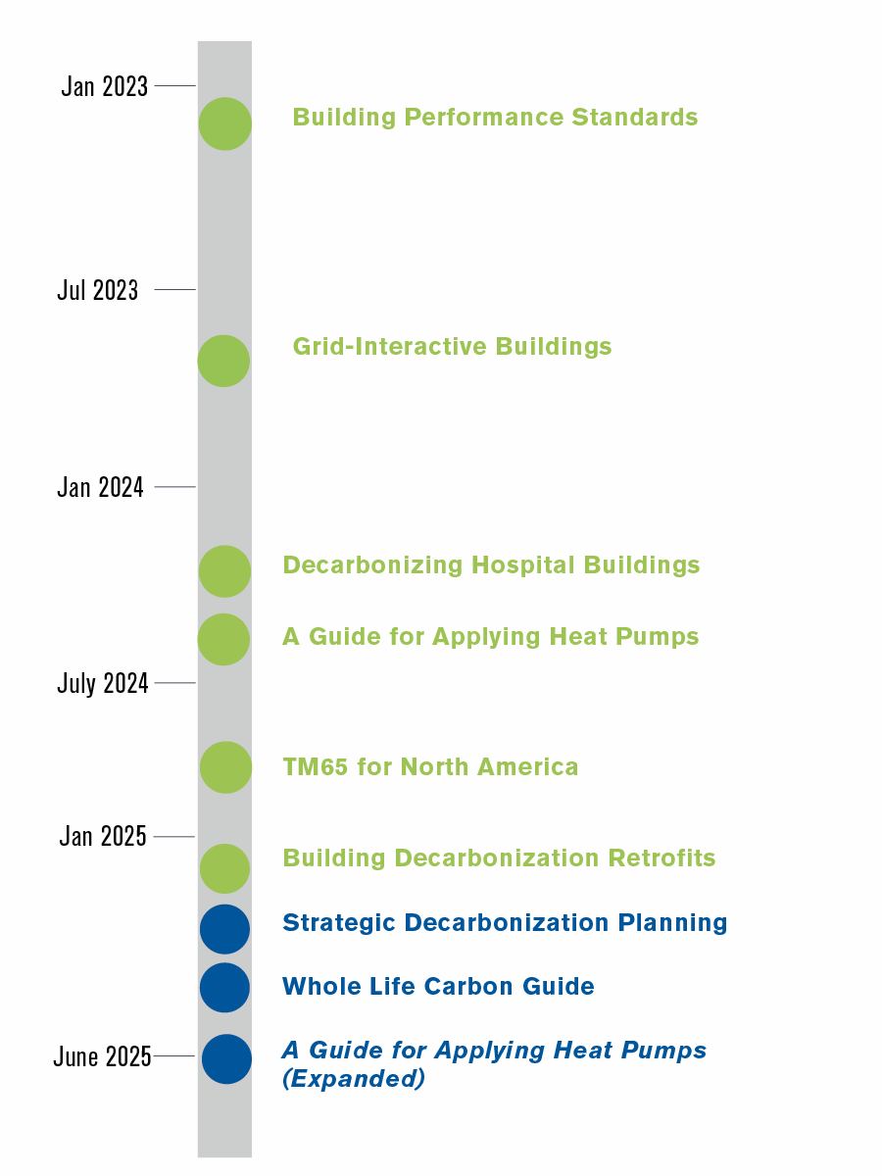

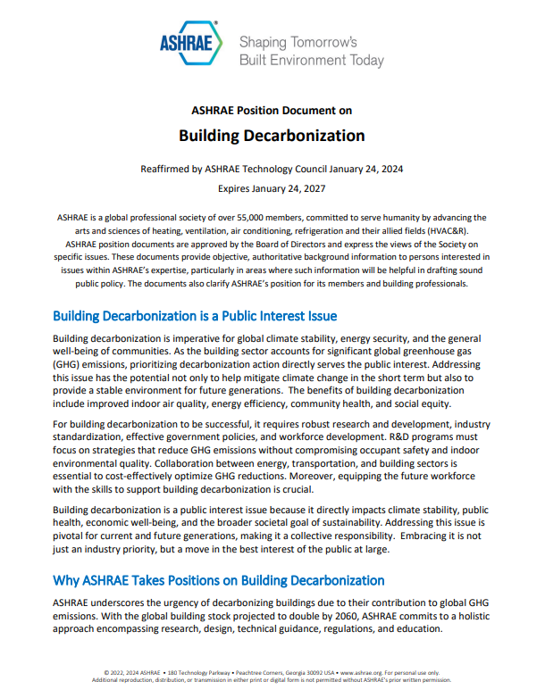
ASHRAE
ASHRAE and Building Decarbonization
Standards and Guidelines
  ASHRAE Standard 90.1
  ASHRAE Guideline 36
Center of Excellence for Building Decarbonization
Guides:
  Decarbonizing Building Thermal Systems: A Guide for Applying Heat Pumps and Beyond
  Grid-Interactive Buildings for Decarbonization
  Building Performance Standards: A Technical Resource Guide
  Decarbonizing Hospital Buildings
  Building Decarbonization Retrofits for Commercial and Multifamily Buildings
ASHRAE Decarbonization Conference
  October 22-24, in Chicago, Illinois
Notes:
Think of this as Part 1 . . . More coming.

Slide 12


Industry Guidance
Decarbonizing Building Thermal Systems: A How-To Guide for Applying Heat Pumps and Beyond
Chapter | Title / Content
1 | Introduction
2 | Selecting the Right Heat Pump for your Project
3 | Designing and Sizing Heat Pumps
4 | Retrofit Applications
5 | Ensuring Success, Reliability, and Longevity: Best Practices in Heat Pump System Installation
Appendix | Heat Pump Basics Building Internal Load Reduction
©2025 Daikin Applied

Slide 13
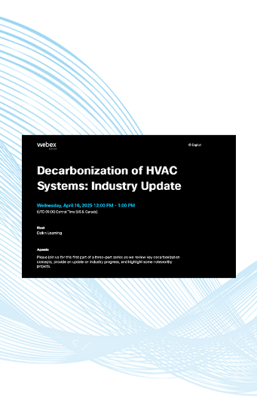
Audience Question
Question 1
Part 1 Recording Available
Do you expect to be involved in a heat pump system design and/or installation?
  Presently involved in one or more projects
  In the next 6-12 months
  In the next 1-2 years
  In the next 3-5 years
  Not sure
Missed the first of our three-part Decarbonization webcast series?
Check out the recording and get up to speed as we dive into the essential concepts of decarbonization with a focus on electrification and heat pump systems.
Industry update
Review of concepts
Systems & solutions
©2025 Daikin Applied

Slide 14
Approach to heat pump systems
Approach
Heat Pumps
Designing & Sizing
Installation & Operation
Notes:
Transitional slide to shift to how regulations are driving behavior

Slide 15
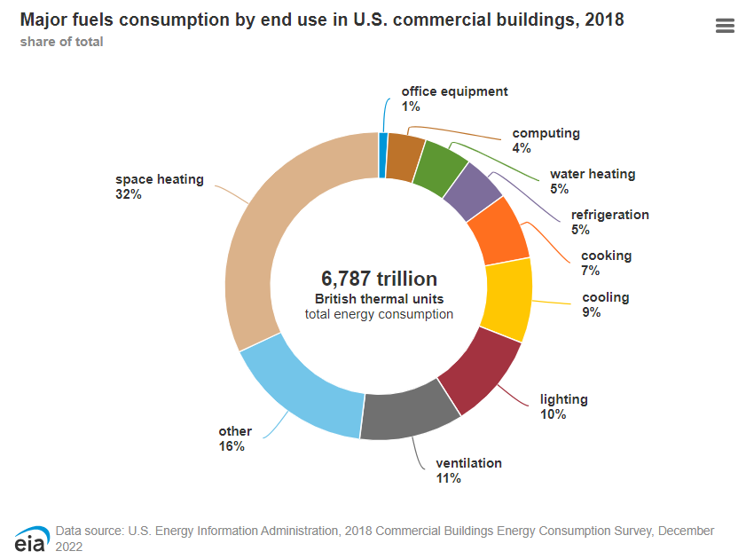
Approach
1
Reduce Building Loads
Improve the envelope
Reduce internal loads
  Lighting
  Plug
  Process
Reduce ventilation heating and cooling loads
Recover heat from simultaneous heating and cooling loads
Investigate reduced nighttime setbacks
Reduce Heating and Cooling System Capacity

Slide 16
Approach
2
3
Use One System for Heating and Cooling
Select Equipment and Design Systems to Mitigate Short Cycling
One heat pump or plant
Instead of boiler and chiller
Reduced space requirements
Reduced electrical capacity
If supplemental heating is required, re-apply existing system
With the heat pump (plant) providing both heating and cooling, it operates at least twice as many hours
More important to limit cycling on and off frequently
How?
  Variable speed
  Staging
  Supplemental heat
  Energy storage
Chiller Plant
Boiler Plant
Heat Pump Plant

Slide 17
Approach
4
5
Minimize Electric Resistance Backup
Use a Phased Approach to Deployment
Low-ambient performance
Ground-source
Thermal energy storage
Re-apply existing heating systems to address peak loads
Develop a plan to address equipment failures
Enable a pathway for full decarbonization

Slide 18
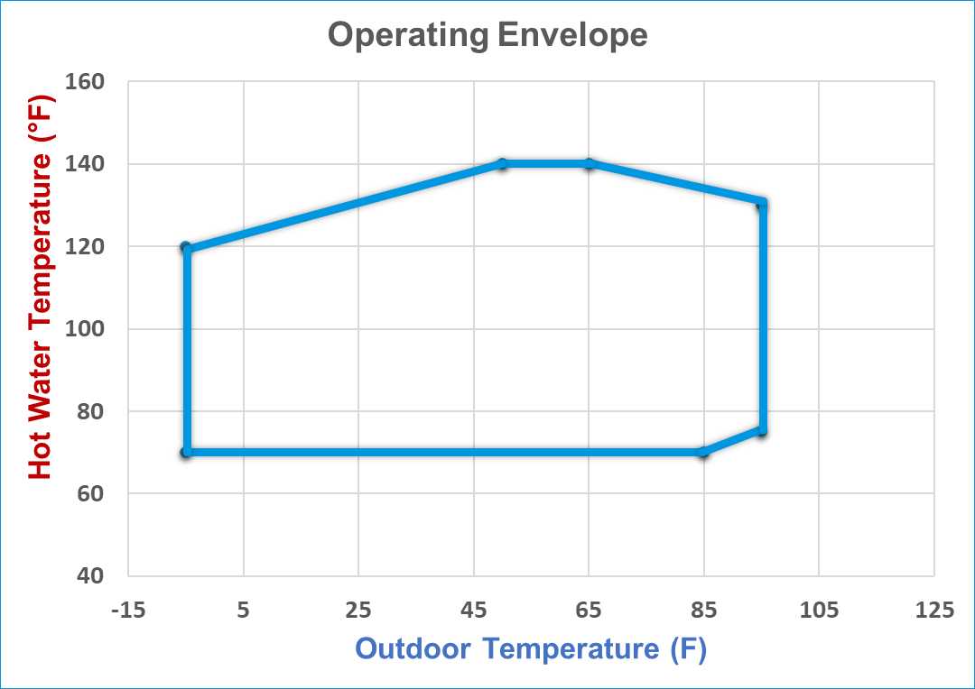
Approach
Refrigerants
Transition to low-GWP refrigerants
A heat pump’s refrigerant determines:
  Operating map and performance
  Low-ambient
  Capacity
  Efficiency
Address refrigerant management and transition as part of decarbonization planning

Slide 19
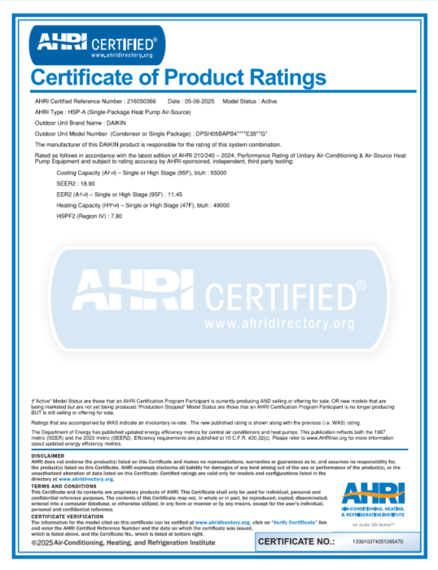

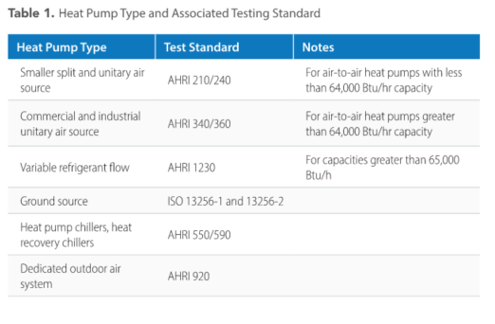
Approach
Codes & Standards
ASHRAE Standard 90.1-2019 and 2022
  New equipment tables
AHRI and ISO test standards
AHRI certificates
  https://ahridirectory.org/
Source: Decarbonizing Building Thermal Systems: A How-To Guide for Applying Heat Pumps and Beyond, NREL

Slide 20
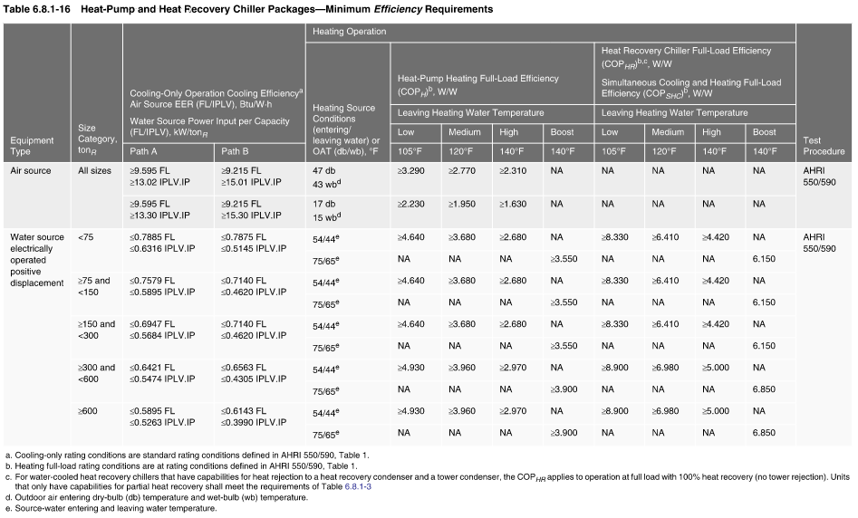
Approach
Codes & Standards
Source: ASHRAE Standard 90.1-2019

Slide 21
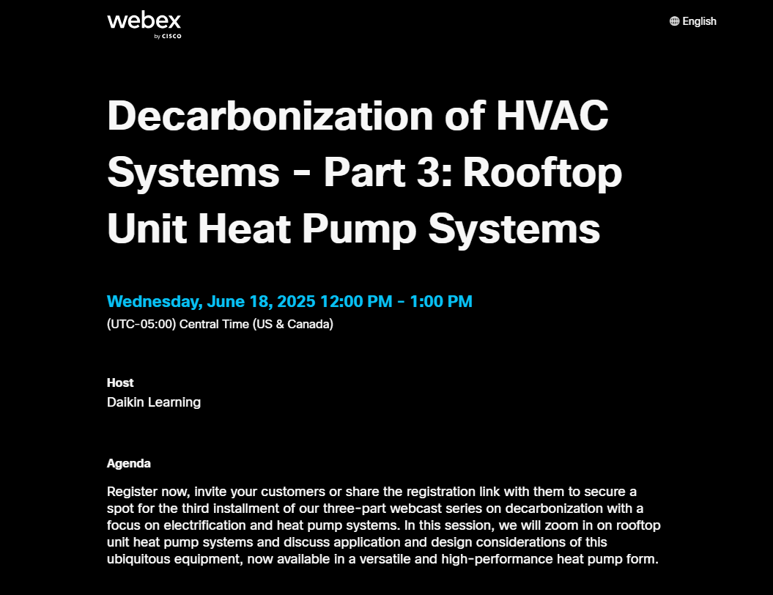
Audience Question
Question 2
Part 3 Coming Up
Considering the approach to heat pump system design and implementation and the guidance to reduce building loads, what do you see as the greatest challenge?
  Improve the envelope
  Reduce internal loads
  Reduce ventilation heating and cooling loads
  Recover heat from simultaneous heating and cooling loads
  Investigate reduced nighttime setbacks
The third installment of our three-part webcast series on decarbonization with a focus on electrification and heat pump systems. In this session, we will zoom in on rooftop unit heat pump systems and discuss application and design considerations of this ubiquitous equipment, now available in a versatile and high-performance heat pump form.

Slide 22
Heat Pumps
Approach
Heat Pumps
Installation & Operation
Designing & Sizing
©2025 Daikin Applied
Notes:
Transitional slide to shift to how regulations are driving behavior

Slide 23
Heat Pump Selection
1
Determine building heating and cooling loads
2
Identify and quantify energy recovery potential
3
Identify heat sources
4
5
6
7
Choose central vs distributed architecture
Choose distribution medium
Choose ventilation control
Assess backup heat requirements

Slide 24
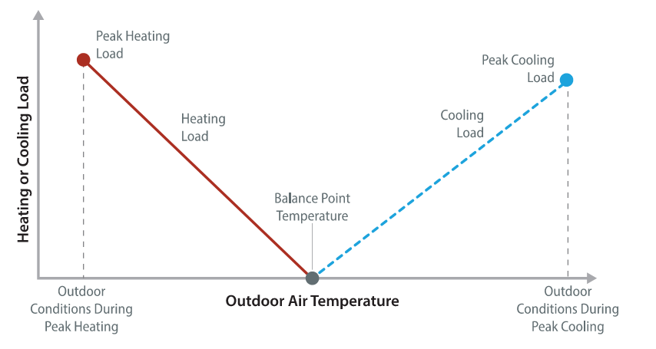
Heat Pump Selection
1
Determine building heating and cooling loads
Size heat pumps for the larger load
Do not include morning warm-up / cool-down
Note outdoor air conditions at peak loads
Determine peak loads:
BAS
Data loggers
Energy model
Caution: When heating loads are greater than cooling loads in humid climates, take care to select a heat pump for proper dehumidification
Consider: All variable speed heat pumps with high turn-down ratios
Transition zone may be a range where heating and cooling are needed
Source: Decarbonizing Building Thermal Systems: A How-To Guide for Applying Heat Pumps and Beyond, NREL

Slide 25
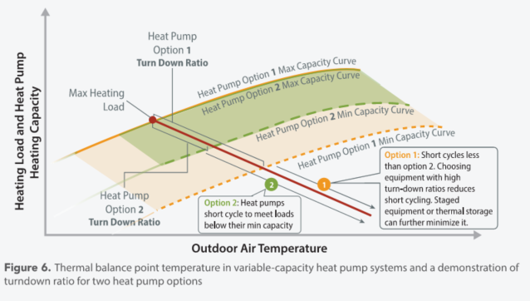
Heat Pump Selection
1
Determine building heating and cooling loads, and address load variation over time
Evaluate turn-down ratio
Heat pump 1 will better address load variation over time
Heat pump 2 will cycle on/off more frequently
Source: Decarbonizing Building Thermal Systems: A How-To Guide for Applying Heat Pumps and Beyond, NREL

Slide 26
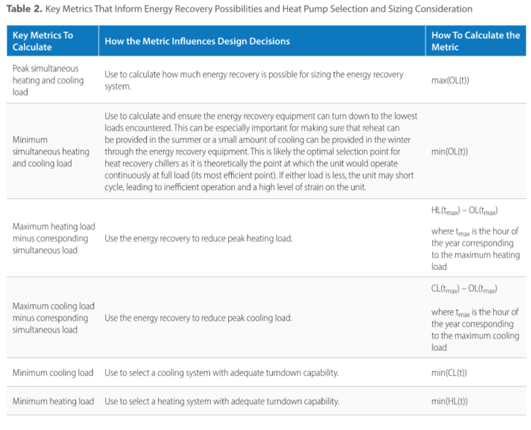
Heat Pump Selection
2
Identify and quantify energy recovery potential
Capture energy from conditioned air leaving the space/building
  Reinject that energy in air entering the space/building
Share energy from simultaneous heating and cooling
  Move heat to where it is needed
    From the core to the perimeter
    From process to space, or from space to process
Source: Decarbonizing Building Thermal Systems: A How-To Guide for Applying Heat Pumps and Beyond, NREL

Slide 27
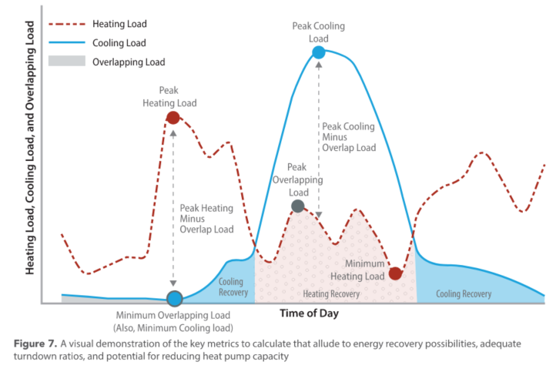
Heat Pump Selection
2
Identify and quantify energy recovery potential
Peak cooling load
Heat recovery
Peak heating load
Heating turn-down requirements
Cooling turn-down requirements
Source: Decarbonizing Building Thermal Systems: A How-To Guide for Applying Heat Pumps and Beyond, NREL

Slide 28
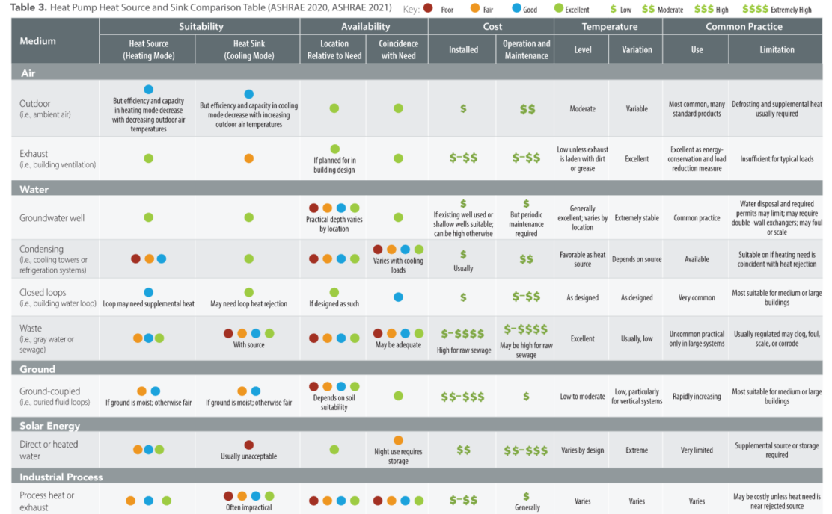
Heat Pump Selection
3
Identify heat sources
Air
Water
Ground
Solar
Process
Source: Decarbonizing Building Thermal Systems: A How-To Guide for Applying Heat Pumps and Beyond, NREL

Slide 29
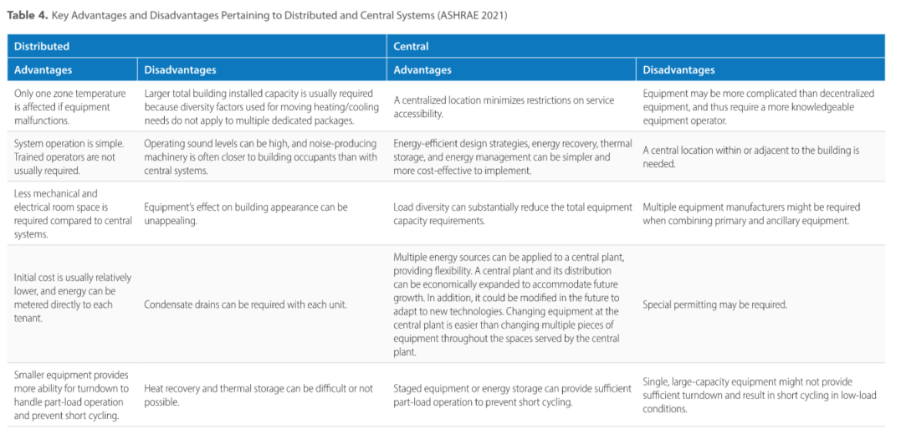
Heat Pump Selection
4
Choose central or distributed architectures
Source: Decarbonizing Building Thermal Systems: A How-To Guide for Applying Heat Pumps and Beyond, NREL

Slide 30
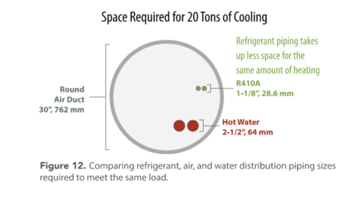
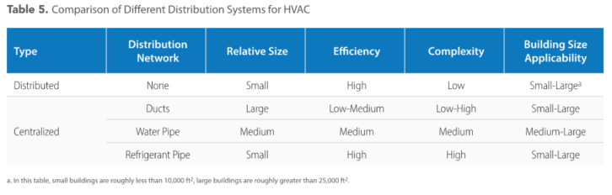
Heat Pump Selection
5
Choose distribution medium (air, water, refrigerant)
Source: Decarbonizing Building Thermal Systems: A How-To Guide for Applying Heat Pumps and Beyond, NREL
System | RTUs | RHP-AHU-VAV | ASHP-WSHP | ASHP-AHU-VAV
Terminal Distribution | Air | Air | Air | Air
Plant Distribution | N/A | Refrigerant | Water | Water

Slide 31
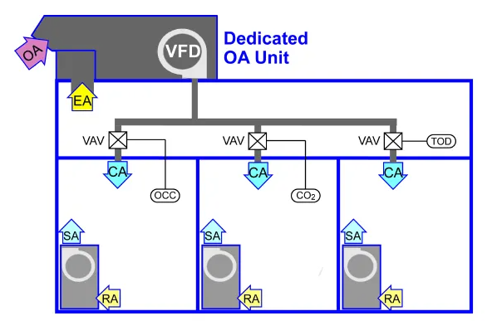
Heat Pump Selection
6
Rebel / Rebel Applied
Trailblazer AGZ-F
Choose ventilation control
Mega Q
Distributed Systems + DOAS
Improved humidity control
Reduced energy use
Simplified ventilation control
Separation of sensible and latent cooling
  Expands options for terminal HVAC equipment
Reduced installation cost
Refer to the ASHRAE Design Guide for Dedicated Outdoor Air Systems
Enfinity or SmartSource WSHPs
Source: ASHRAE Design Guide for Dedicated Outdoor Air Systems (ASHRAE 2017)

Slide 32
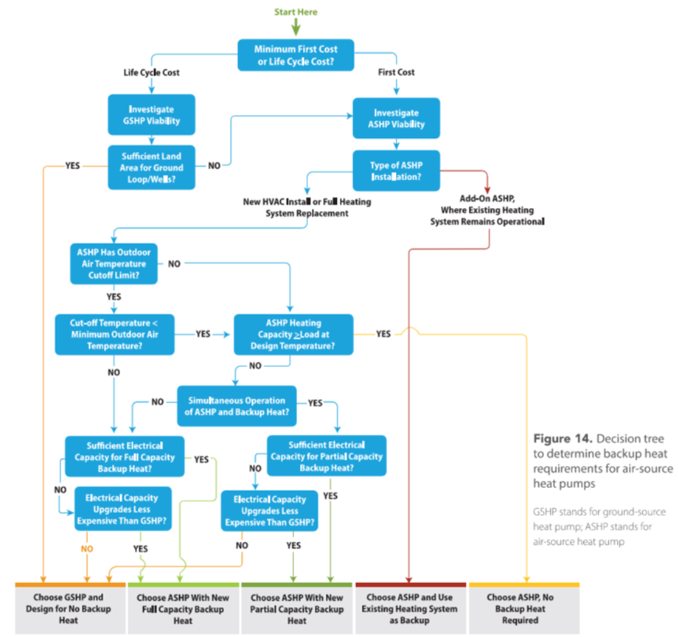
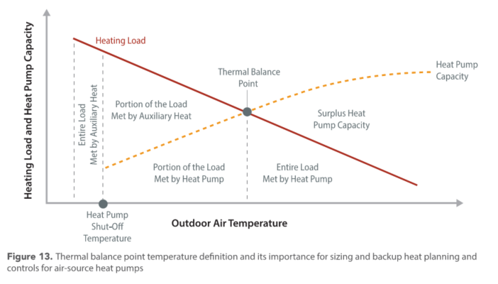


Heat Pump Selection
7
Assess backup heat requirements
Thermal balance point at intersection of heating load line and heat pump capacity curve
Maximum heat pump heating capacity
Capacity $=f(OAT)$
Load $=f(OAT)$
Low ambient operation
Supplemental heat
Source: Decarbonizing Building Thermal Systems: A How-To Guide for Applying Heat Pumps and Beyond, NREL
Notes:
Heat pump operate with supplemental heat simultaneous? Rebel!

Slide 33
Heat Pump Selection
7
Assess backup heat requirements . . . minimize or eliminate backup heat
Strategy | Notes
Size the heat pump system for peak heating (the larger load), at the associated design outdoor air temperature, while ensuring variable-speed capability for compressors and fans. | Ensures the system can modulate capacity to meet loads Minimizes excessive cycling
Design for multiple smaller heat pumps instead of a single large heat pump. | More staging options Heat pumps can operate in various modes to meet the load
Explore the use of ground-source heat pumps. | Leverages stable ground temperature
Explore the use of energy storage. | Store heat during periods of high heat gain to be used when needed
Reduce nighttime temperature setback. | Take advantage of thermal inertia to reduce peak warm-up or cool-down loads
Decouple ventilation and return air. | Reduces overall building load Combine with energy recovery

Slide 34
Heat Pump Selection
7
Assess backup heat requirements . . . Additional heating considerations
Heat Type | Notes
Electric Resistance | Maintain existing baseboard or VAV box reheat For hydronic systems, an electric boiler may be used If carbon emissions are important, consider emissions factors due to electric heat
Air-To-Water Heat Pump | Use a heat pump as supplemental heat! For example, to heat the thermal loop of a water source heat pump system Combine with thermal storage to shift heating to the warmest and most efficient time of day
Natural Gas | Reuse existing heating system for peak loads and backup heat This makes sense: When there isn’t enough existing electrical capacity to power auxiliary electric heat For backup heat purposes so that during a power outage, the electrical load is limited to the fans When the life cycle carbon of keeping the gas equipment is lower

Slide 35
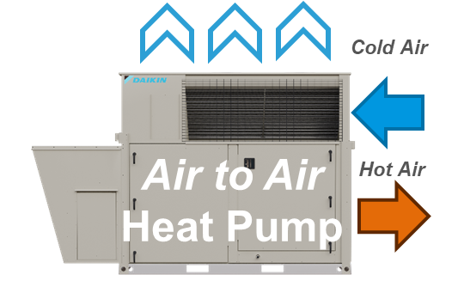
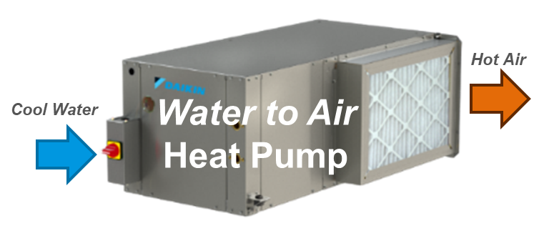
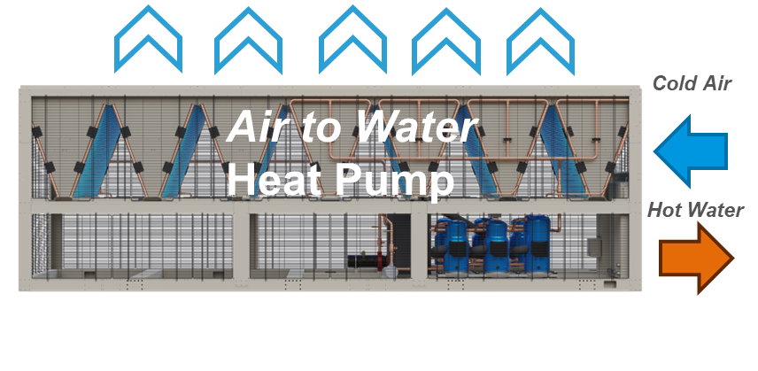
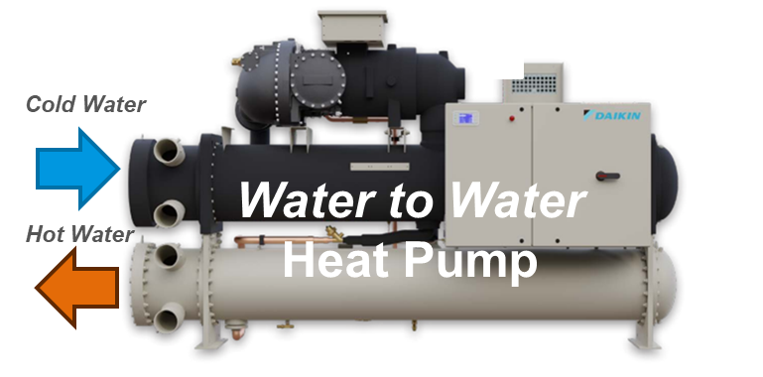
Heat Pumps
Air-to-Air
RTU
Water-to-Air
WSHP
Packaged
Air-to-Water
Water-to-Water
Heat Recovery
Chiller-Heater
Types
Air-to-Air
Water-to-Air
Air-to-Water
Water-to-Water

Slide 36
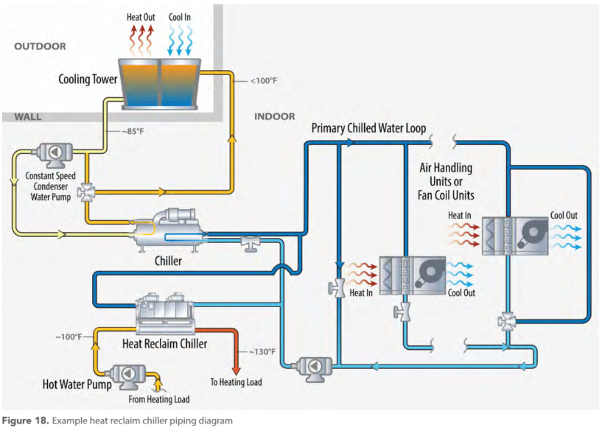
Heat Pumps
Heat Recovery
Heat recovery yields useful heat and reduces heat rejected to the ambient environment (and wasted)
Heat recovery chiller pre-cools return chilled water, and provides hot water to the heating load
Source: Decarbonizing Building Thermal Systems: A How-To Guide for Applying Heat Pumps and Beyond, NREL

Slide 37
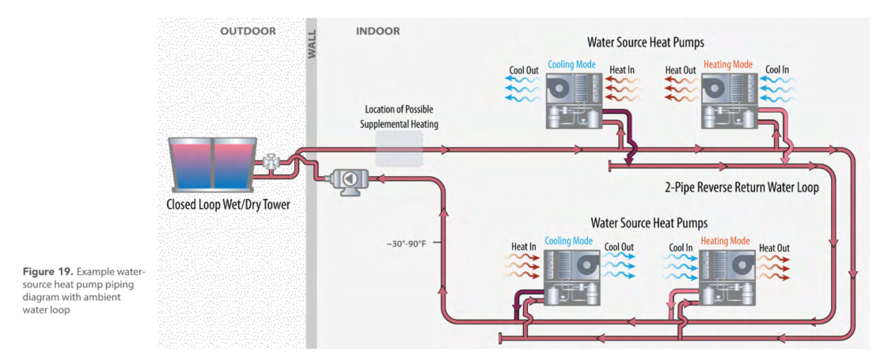
Heat Pumps
Water Source Heat Pumps
Insert heat pump here
Source: Decarbonizing Building Thermal Systems: A How-To Guide for Applying Heat Pumps and Beyond, NREL
Thermal loop

Slide 38
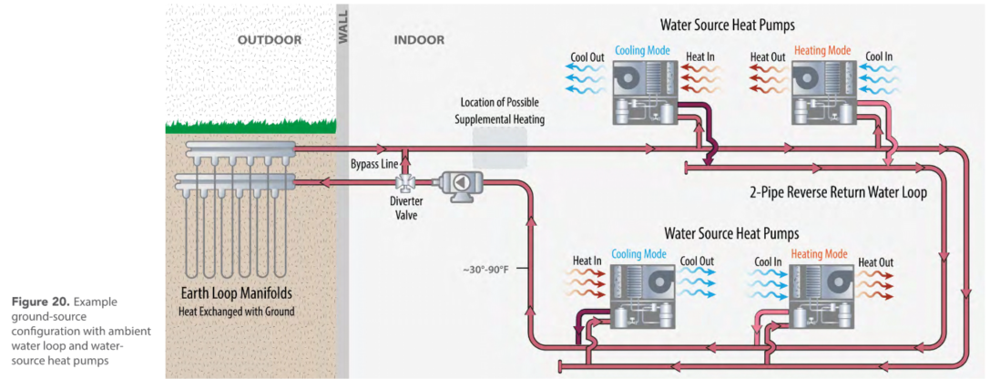
Heat Pumps
Water Source Heat Pumps
Insert heat pump here
Combine with heat pump for hybrid geothermal system
Source: Decarbonizing Building Thermal Systems: A How-To Guide for Applying Heat Pumps and Beyond, NREL
Thermal loop

Slide 39
Designing & Sizing
Approach
Heat Pumps
Installation & Operation
Designing & Sizing
©2025 Daikin Applied
Notes:
Transitional slide to shift to how regulations are driving behavior

Slide 40
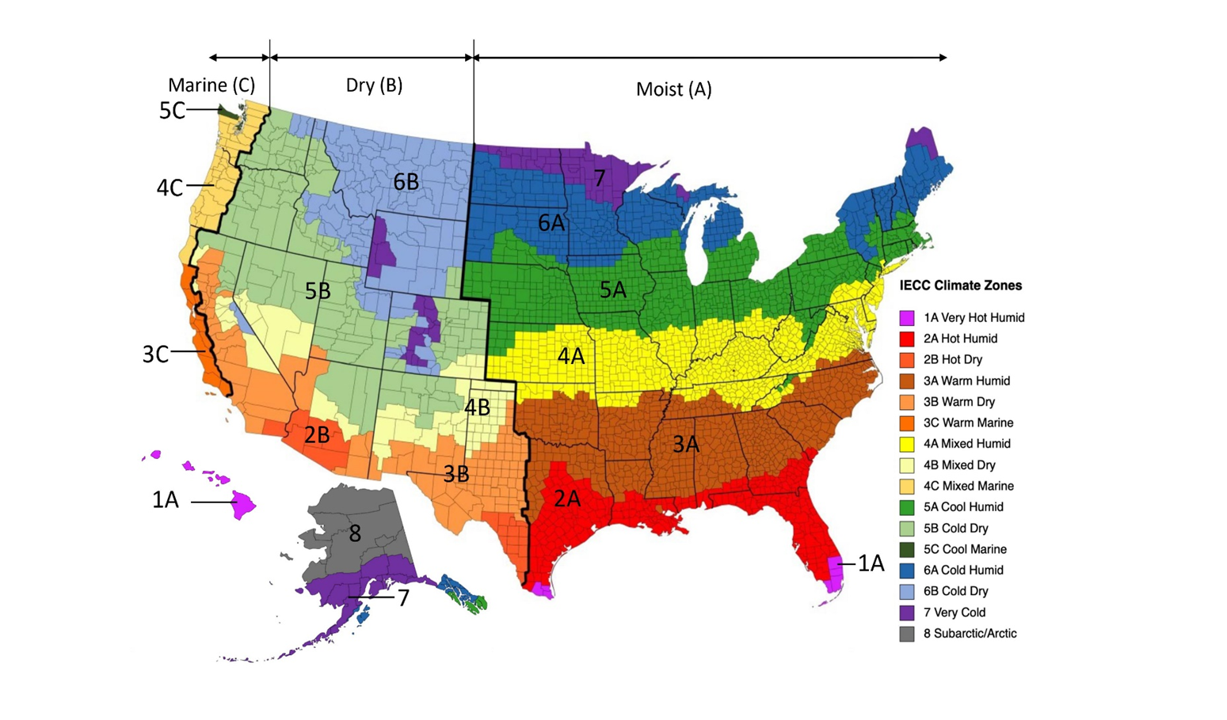
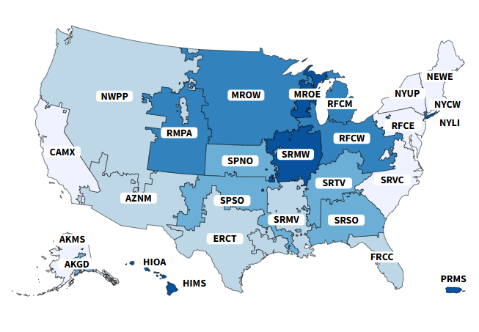
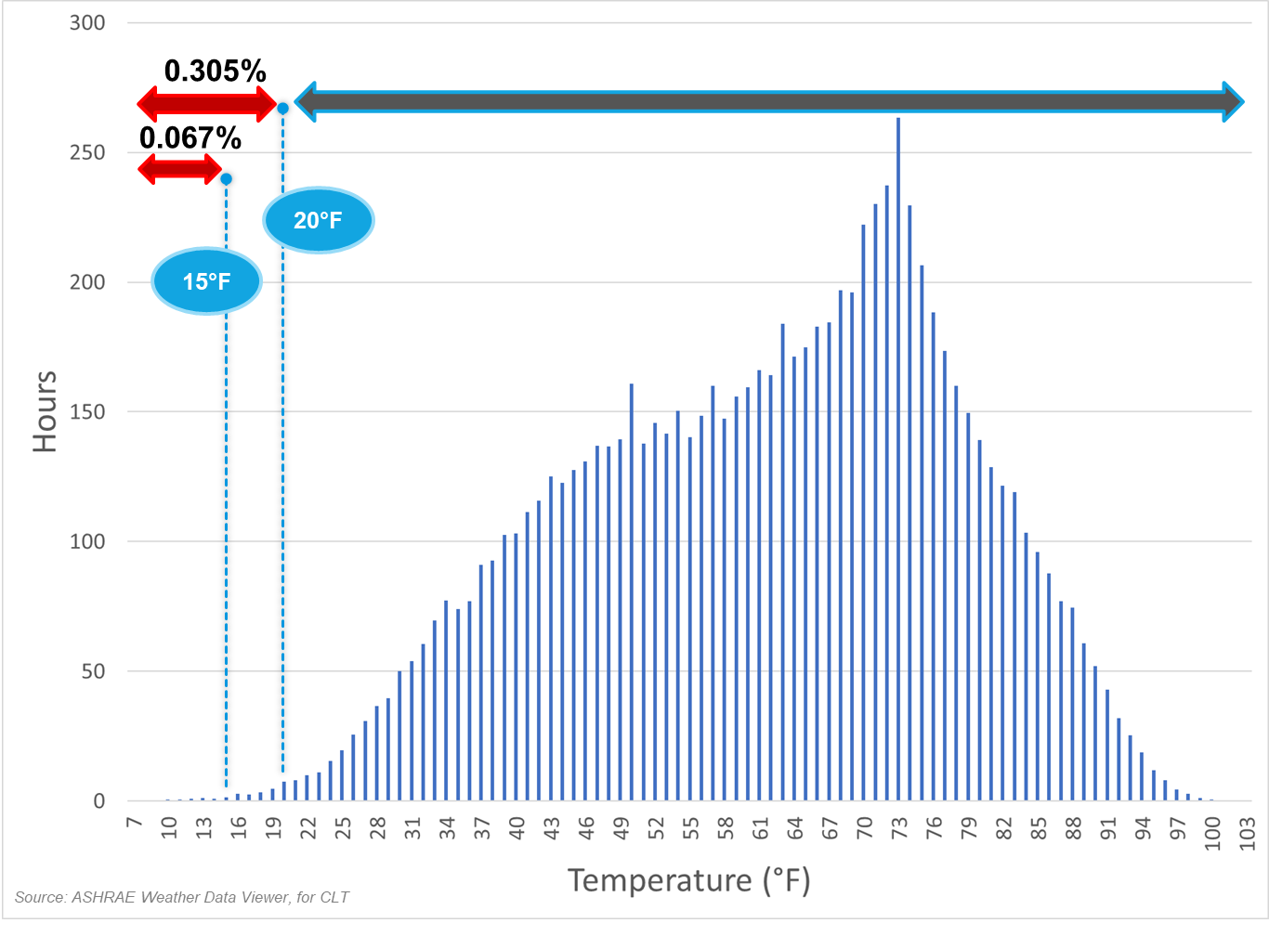
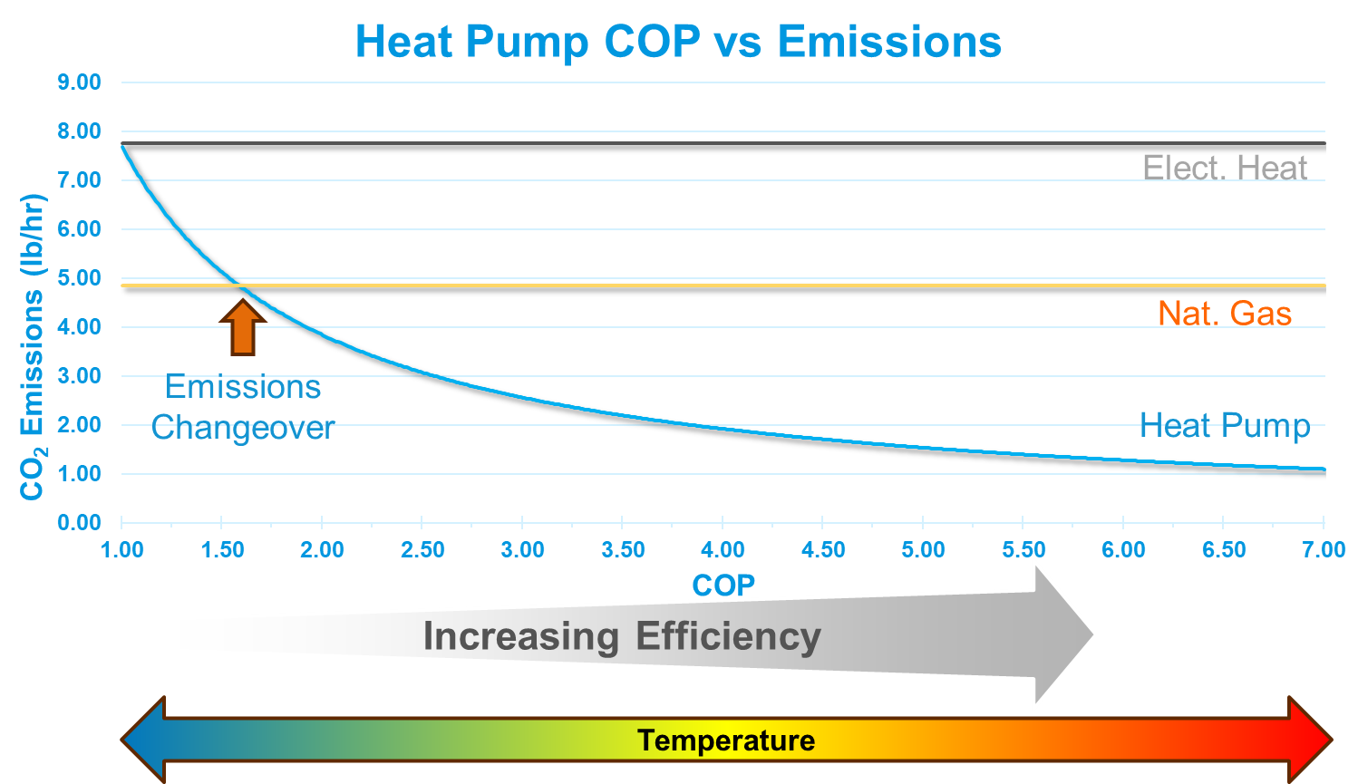
Heat Pump Systems Application & Design
Climate Zones
Grid Emissions
Review
Building
  Envelope
  Infrastructure
  Temperatures
Climate
Emissions
  Rates
Utilities
  Power
  Incentives
  Rates
Source: US Department of Energy
Source: US EPA eGRID

Slide 41
Heat Pump System Design & Sizing
1
Determine the general system configuration
2
Run a load calculation for the building
3
Map hourly loads for heating and cooling
4
5
6
Choose central vs distributed architecture
Simulate system performance
Iterate on design to optimize performance

Slide 42
Heat Pump System Design & Sizing
1
Determine the general system configuration
System requirements
  Space
    Temperature setpoints
    Humidity setpoints
    Ventilation
  Zoning
    Single-zone
    Multi-zone
  Control strategies
    Setbacks
    Ventilation
New Construction | Existing Building / Retrofit
Distributed: Determine peak loads in each space
Centralized: Determine peak loads in each space, plus building load
Model | Measure + Model

Slide 43
Heat Pump System Design & Sizing
2
Run a load calculation for the building
8760
Model
Design Conditions
Building
Measured Data
Layout
Construction
Occupancy / diversity
Design day
Internal loads
Schedules
Weather
Code requirements
BAS / controls
Data loggers
Meters
Source: Decarbonizing Building Thermal Systems: A How-To Guide for Applying Heat Pumps and Beyond, NREL
Notes:
Sammy takes this one!

Slide 44
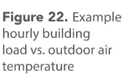

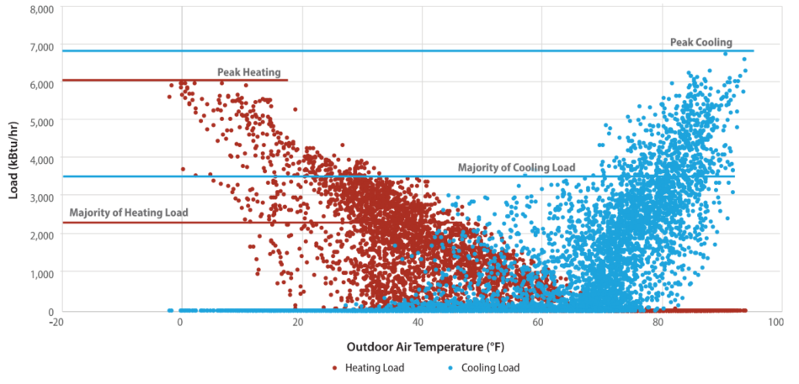
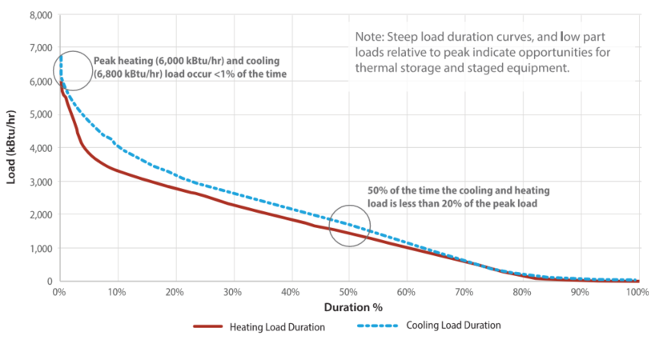
Heat Pump System Design & Sizing
3
Map hourly loads for heating and cooling
Peak loads occur for a very small percentage of operation
Note opportunities for control strategies, supplemental heat, energy storage
Measured existing building data
Source: Decarbonizing Building Thermal Systems: A How-To Guide for Applying Heat Pumps and Beyond, NREL

Slide 45
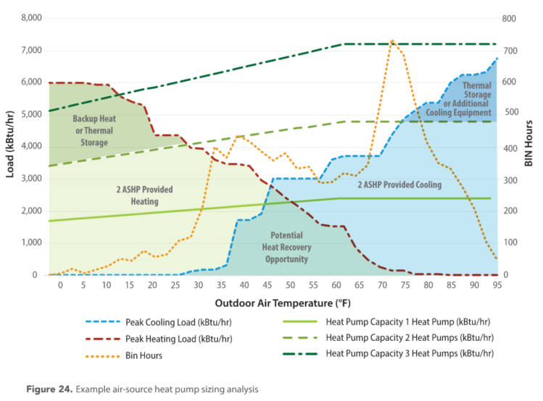
Heat Pump System Design & Sizing
4
Select equipment size based on load profiles
Peak cooling load
Peak heating load addressed by supplemental heat or thermal storage
Heat recovered from cooling for heating
Source: Decarbonizing Building Thermal Systems: A How-To Guide for Applying Heat Pumps and Beyond, NREL

Slide 46
Heat Pump System Design & Sizing
5
Iterate on design to optimize performance
Simulate system performance
6
Consider multiple scenarios / configurations
Use an energy model or spreadsheet-based tool to answer the following:
  Can the system meet load requirements?
  Can setpoints be maintained?
  What are . . .
    Energy usage and cost?
    Carbon emissions?
System Configuration
Load Calculation
Map Hourly Loads
Equipment Selection
Simulation

Slide 47
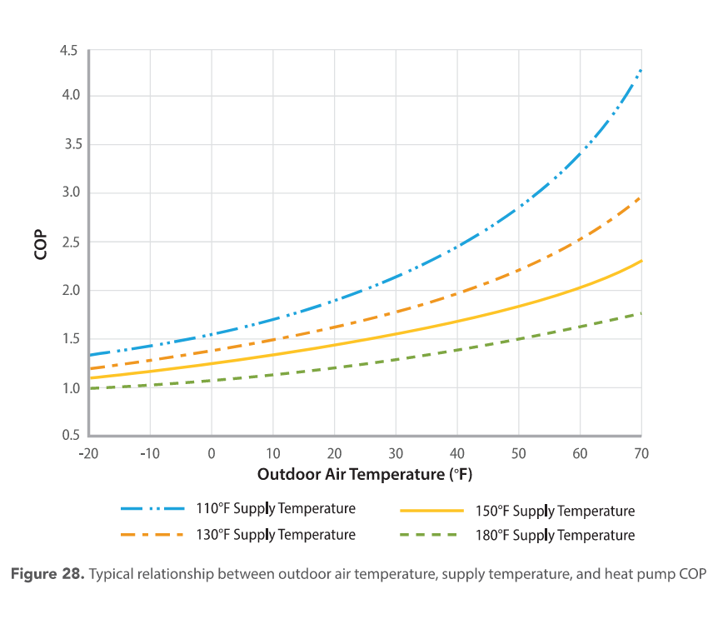
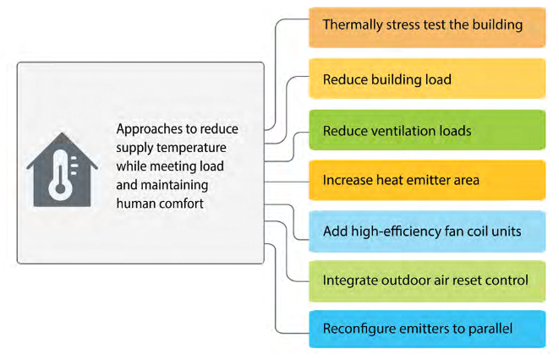

Heat Pump System Design & Sizing
Design for Minimum Supply Temperature
Why?
How?
Increasing efficiency
Source: Decarbonizing Building Thermal Systems: A How-To Guide for Applying Heat Pumps and Beyond, NREL
Source: Decarbonizing Building Thermal Systems: A How-To Guide for Applying Heat Pumps and Beyond, NREL

Slide 48
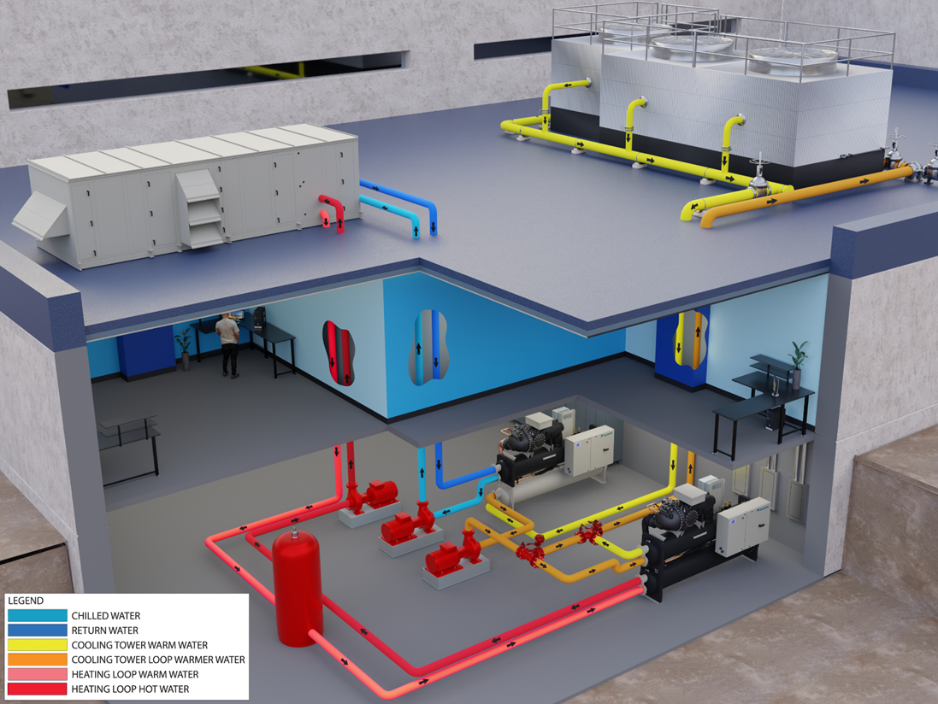
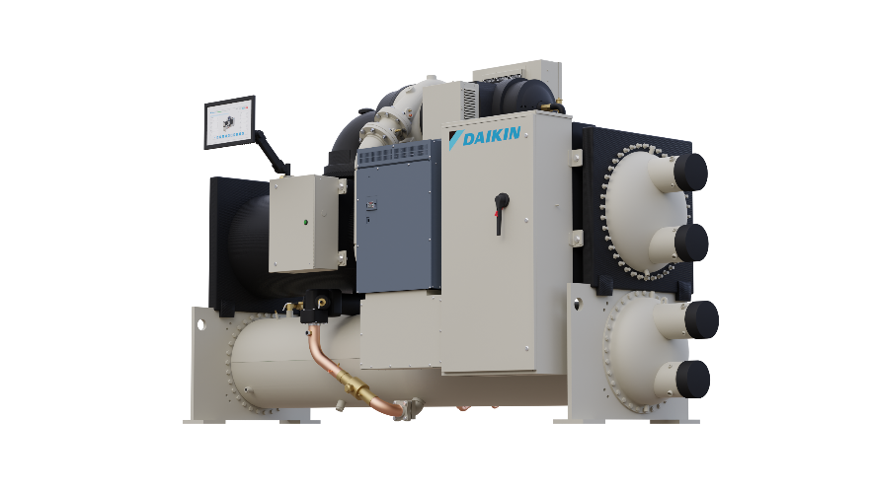
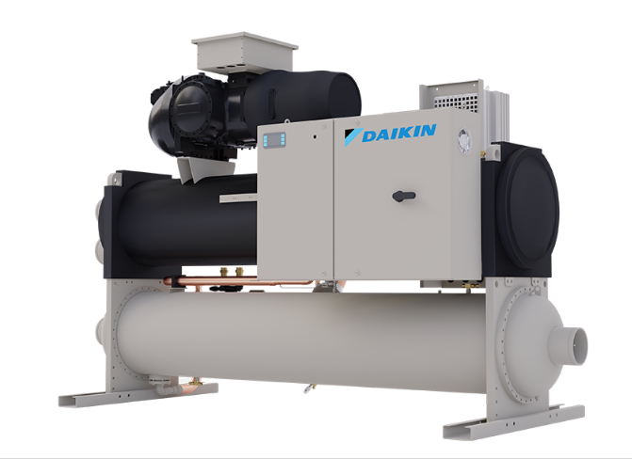
Audience Question
Question 3
Heat Recovery
What percentage of projects that you are involved with employ energy modeling in planning and design?
  On a scale of 1 to 5
  1 = 0% to 20%
  2 = 20% to 40%
  3 = 40% to 60%
  4 = 60% to 80%
  5 = 80 to 100%
Please put any additional comments in the chat.
Magnitude® WME-D
Navigator TWV
Templifier® Water Heater

Slide 49
Retrofits
1
Use a phased approach
2
Collect project-level information
3
Evaluate existing building conditions
4
5
6
Evaluate existing mechanical systems
Identify space for new heat pump and distribution equipment
Thermal stress test the building
Evaluate building electrical capacity
7

Slide 50
Retrofits
1
Use a phased approach
Put your building on a path to decarbonization
Plan for systems and equipment replacements in advance
Apply a whole building perspective
Use off-the-shelf solutions
Consider separating air quality/ventilation/humidity control from sensible control
Use existing heating systems for peak demand
Enable lower hot water temperatures through distribution system upgrades
“A phased replacement strategy gives time for decision makers to plan the next steps and review options for load reduction, ventilation management, smart controls, and optimal system choices without having to fully replace all systems at once.”

Slide 51
Retrofits
2
Collect project-level information
Building
Start with the building:
  Type
  Size (square footage)
  Utility data
    Monthly
    15-minute interval data
  Benchmark, per square foot:
    Energy
    Cost
Then, systems:
  Envelope
  Electrical
  Mechanical
  Plumbing
For existing buildings, deploy data logging
Envelope
HVAC
Plumbing
Domestic Hot Water
Process
Mechanical
Electrical
Lighting
Plug Load
Process
Insulation
Roofing
Walls
Windows
Piping

Slide 52
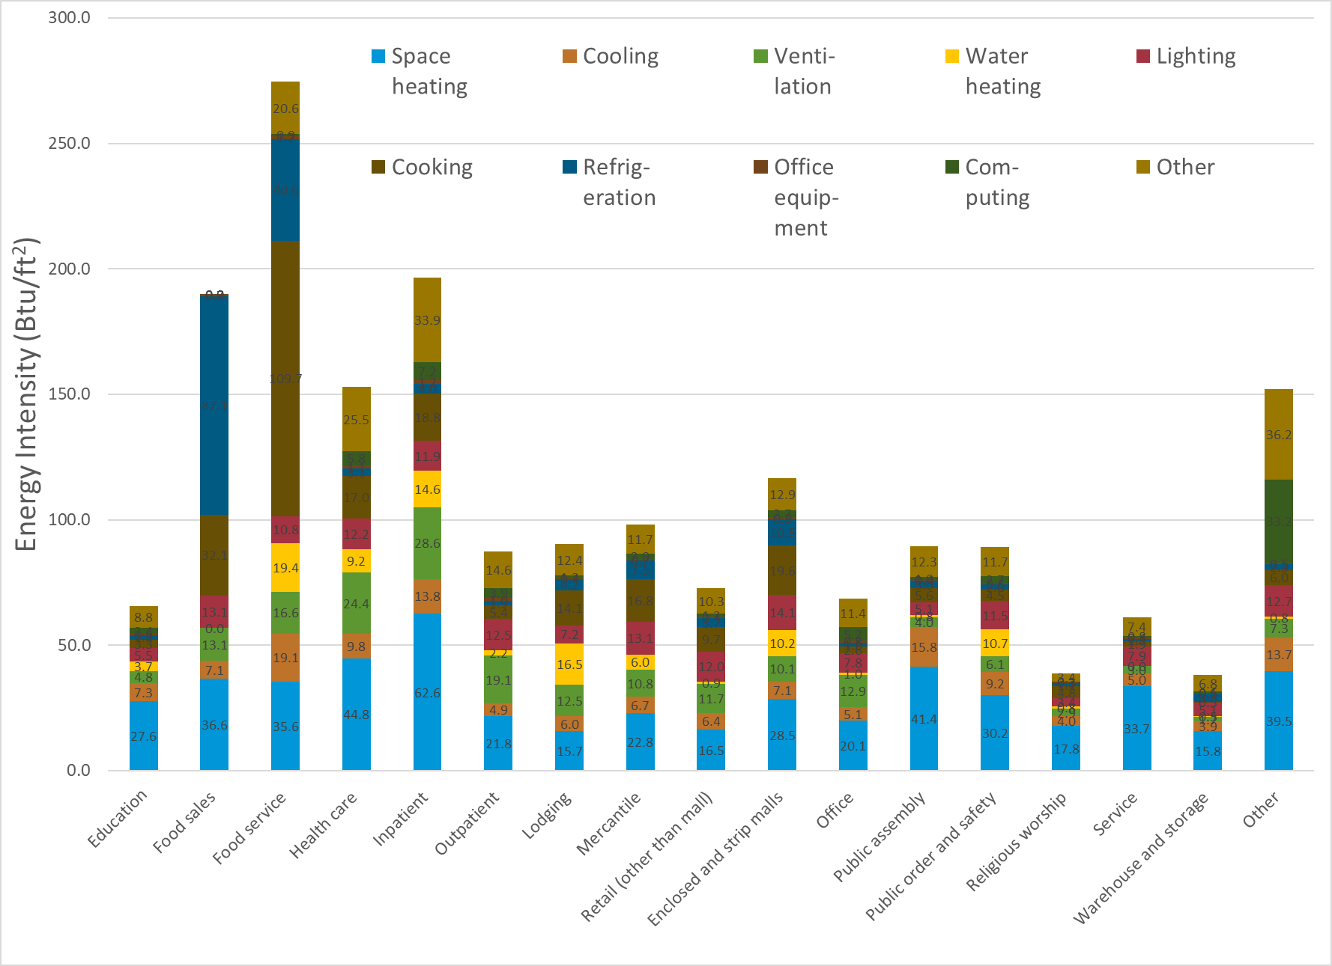
Retrofits
3
Evaluate existing building conditions
BAS and controls
  Data
Envelope
  Insulation
  Roofing
  Walls
  Windows
Electrical
  Lighting
  Plug load
  On-site generation/storage
Process
Source: US EIA 2018 CBECS

Slide 53
Retrofits
Thermal Distribution: Air, Refrigerant, Water
4
Evaluate existing mechanical systems
BAS and controls
  Actuators
  Sensors
  Valves
  Data
Mechanical
  HVAC
    Central plant
    Terminal units
    Ventilation
    Distribution
  Thermal storage
Plumbing
  Domestic hot water
Supporting structure
Air Distribution / Ventilation: AHUs, RTUs
Terminal Units: FC, UV, VAV, IU, WSHP
Plant: A/C, W/C, HP, VRV
• Ductwork and pipe sizes
• Distribution system pressure classification
• Existing distribution system material
• Existing damage or leaks
• Existing condition and R value of insulation
• Condition and operation of control actuators
• Maintenance access distribution components.
Domestic hot water

Slide 54
Retrofits
5
Identify Space for New Heat Pump and Distribution Equipment
Evaluate existing equipment location(s) and potential new location(s)
Key Considerations
System Type | Considerations
Air-Source Heat Pumps | Clearance for air flow Strategic locations, for example in an underground parking garage Defrost
Ground-Source Heat Pumps | Bore field Distribution - thermal loop piping
Water-Source Heat Pumps | Distribution - thermal loop piping
Distribution Systems | Space for piping and ductwork Piping chases Plenum space Ceiling space Structure Fire protection piping Electrical wiring and conduit
Factors:
  Structure
  Penetrations
  Electrical service
  Footprint
  Distribution

Slide 55
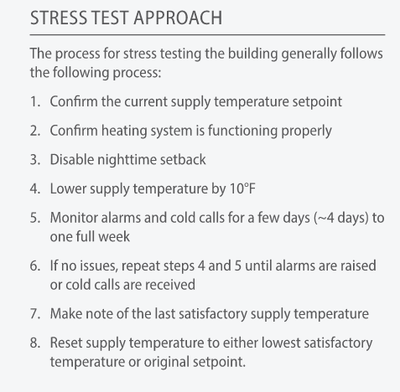
Retrofits
6
Thermal stress test the building
Systematically lower the heating supply setpoint
Allows the building to respond
  Thermal mass
  Controls
Prior to test:
  Verify proper heating system operation
  Inspect system, including distribution
  Investigate and repair existing problems
During the test, monitor:
  When ambient room temperature falls out of acceptable range
  When heating pump or fan speed reaches 100%.
  When pipe main velocity reaches 8 feet per second
  When building occupants complain about thermal comfort.
Source: Decarbonizing Building Thermal Systems: A How-To Guide for Applying Heat Pumps and Beyond, NREL

Slide 56
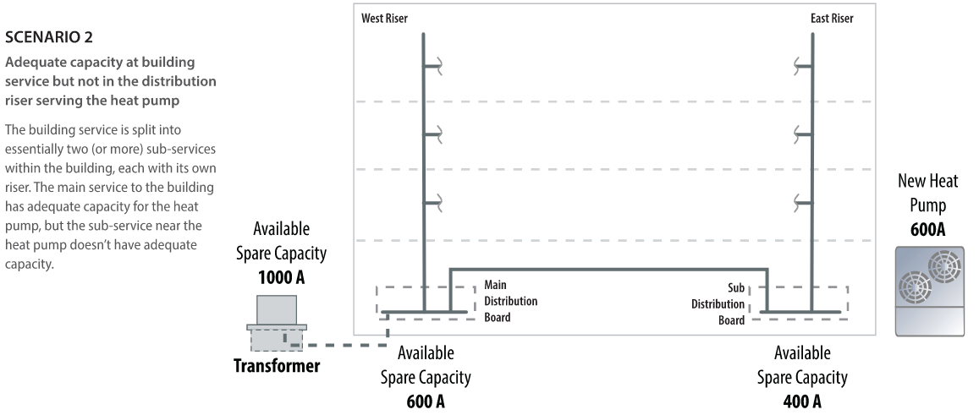
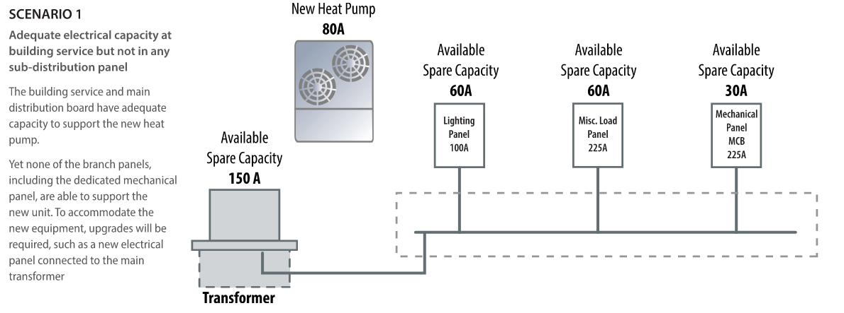
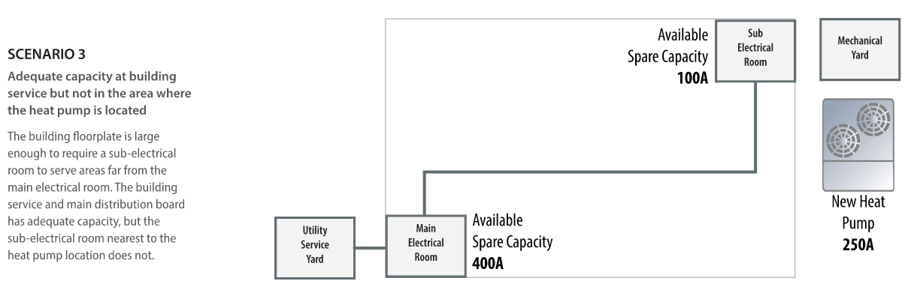
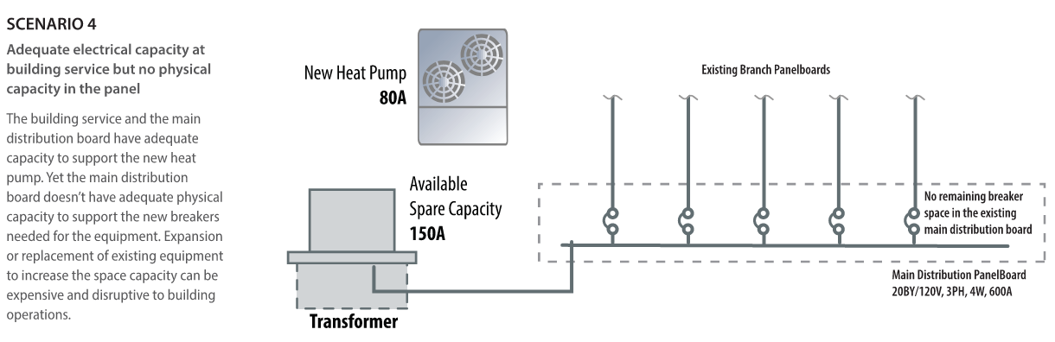
Retrofits
7
Evaluate building electrical capacity
Adequate electrical capacity at building service, but not in any sub-distribution panel
Adequate electrical capacity at building service but not in the distribution riser serving the heat pump
Adequate capacity at building service but not in the area where the heat pump is located
Adequate electrical capacity at building service but no physical capacity in the panel
Source: Decarbonizing Building Thermal Systems: A How-To Guide for Applying Heat Pumps and Beyond, NREL, Figures 37-40

Slide 57
Retrofits
7
Evaluate building electrical capacity
Electrical distribution equipment can often have remaining electrical capacity due to differences between National Electrical Code requirements and actual operating conditions.
  But consideration must be given to the specific location of the available capacity throughout the entire distribution system, not just the main service switchboard.
Even if the main distribution board has capacity, if the new equipment is not physically near and connecting directly to that main board…
  There may be downstream capacity bottlenecks that make the addition of new equipment more difficult and expensive.
Both electrical and physical capacity are important.
  Expanding the physical capacity of a distribution board can be difficult and costly, so understanding this need early in a project design is critical.
Reducing or eliminating backup heat, and reducing equipment size…
  Helps alleviate the potential electrical capacity constraints that might be present in a building and should be considered before electrical infrastructure upgrades.
Physical Capacity
Electrical Capacity
Location
Breaker space
Capacity in the local infrastructure nearest to the equipment
Building service
Transformers
Panels
Switch gear

Slide 58
Retrofit Scenarios
Scenario | Scenario | Solution Pathways
1 | Steam Radiators with Split System Air Conditioning | Maintain Existing Air-Conditioning Units; Replace Steam with New Air-to-Water Heat Pump Replace Existing Air Conditioning and Steam with Air-to-Air Heat Pumps and DOAS System Replace Existing Air Conditioning and Steam Ambient Loop with Water-Source Heat Pumps
2 | Single Zone Direct Expansion RTUs with Natural Gas Heat | Replace Existing RTU with Heat Pump RTUs Replace Existing RTU with Heat Pump RTUs and DOAS Replace Existing RTUs with VRF or Minisplit Heat Pumps and DOAS
3 | Variable Air Volume Direct Expansion Air Handling Unit with Natural Gas Reheat | Replace the Existing Hot Water Boiler with an Air-to-Water Heat Pump Replace Existing VAV Air Handling Unit with VAV Heat Pump RTU Replace Existing RTUs with VRF or Minisplit Heat Pumps and DOAS Replace Existing RTU with Ambient Loop and Water-Source Heat Pumps
4 | Single Duct VAV Direct Expansion Air Handling Unit with Electric Reheat | Replace Existing VAV Air Handling Unit with VAV Heat Pump RTU Replace Existing RTUs with VRF or Minisplit Heat Pumps and DOAS Replace Existing RTU with Ambient Loop and Water-Source Heat Pumps
5 | Existing Central Plant (Chilled Water and Hot Water) | Replace Existing Chiller and Boiler with Air-to-Water Heat Pumps Replace Existing Chiller and Boiler with Ambient Loop and Water-Source Heat Pumps

Slide 59
Installation & Operation
Approach
Heat Pumps
Installation & Operation
Designing & Sizing
©2025 Daikin Applied
Notes:
Transitional slide to shift to how regulations are driving behavior

Slide 60
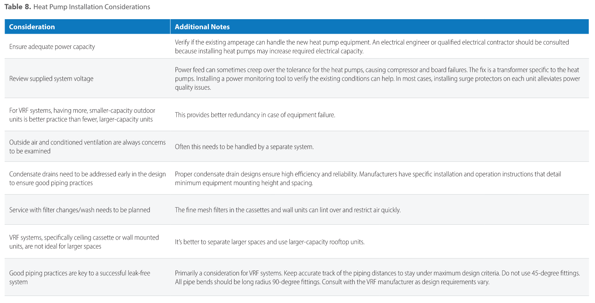
Installation
Best practices
Eliminate refrigerant leaks
Submeter
Preserve the existing heating system
Avoid unnecessary electrical upgrades
Prioritize air sealing
Make provisions for internal condensate drainage
Source: Decarbonizing Building Thermal Systems: A How-To Guide for Applying Heat Pumps and Beyond, NREL

Slide 61
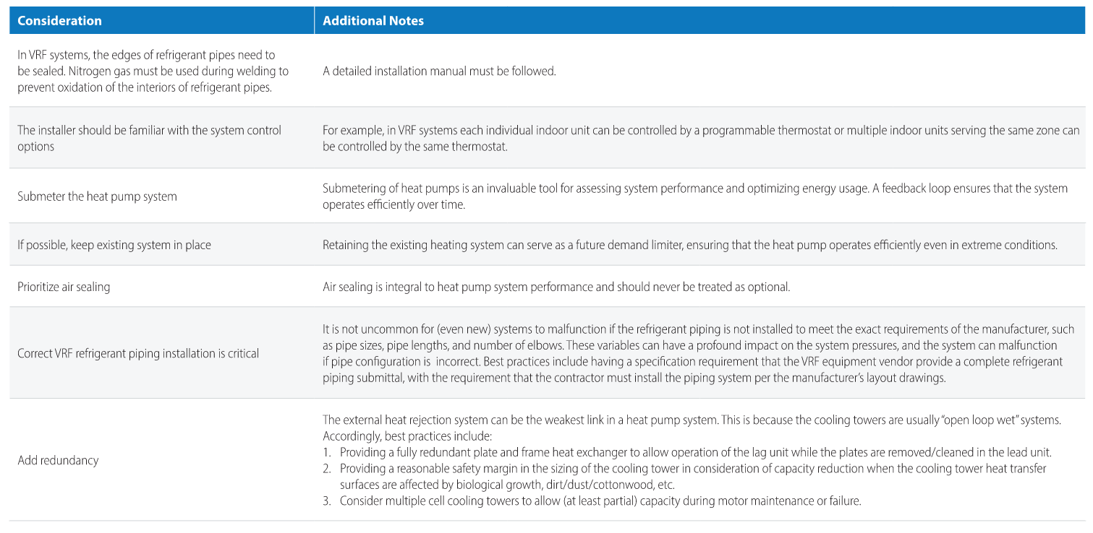
Installation
Best practices
Note that multiple considerations pertain to VRF systems specifically
Source: Decarbonizing Building Thermal Systems: A How-To Guide for Applying Heat Pumps and Beyond, NREL

Slide 62
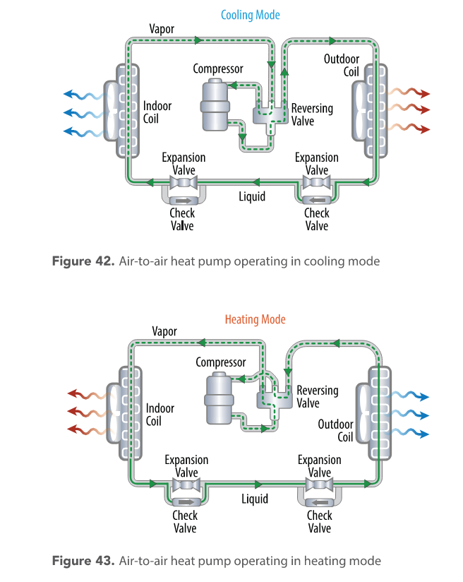
Appendices
Heat Pump Basics
Building Internal Load Reduction
Lighting
  Assessment
  Design
  Controls
Plug and process loads
  Load reduction strategies
  Controls
Other Loads
  Vertical transport
  Computing
  Food service
  Natatorium
Source: Decarbonizing Building Thermal Systems: A How-To Guide for Applying Heat Pumps and Beyond, NREL

Slide 63

Audience Question
Question 4
Case Study
Based on this presentation, how would you characterize the difficulty of designing and sizing a heat pump system (relative to mainstream applied HVAC systems)?
  On a scale of 1 to 5
  1 = Very Easy
  2 = Easy
  3 = Neutral
  4 = Difficult
  5 = Very Difficult
Please put any additional comments in the chat.

Slide 64
Where Can I Go for Information?
Selected Resources
https://www.ashrae.org/about/cebd-center-of-excellence-for-building-decarbonization
https://www.ashrae.org/about/cebd-building-decarb-101
US Department of Energy: Decarbonizing the U.S. Economy by 2050: A National Blueprint for the Buildings Sector
Decarbonization Guides
  Decarbonizing Building Thermal Systems: A How-To Guide for Applying Heat Pumps and Beyond
Pathways to Commercial Liftoff: Geothermal Heating and Cooling
©2025 Daikin Applied

Slide 65

Where Can I Go for Information?
Selected Resources
Dedicated web site
On demand webinars:
  The Path to Decarbonization for Applied HVAC
    Part 1: Overview
    Part 2: Systems & Solutions (Coming soon)
  Decarbonization in HVAC
    Part 1: Update & Review
    Part 2: Thermal Systems Guidance
    Part 3: RTU Heat Pumps
  Refrigerants
    Preparing Buildings for A2L Refrigerants
https://www.daikinapplied.com/decarbonization
©2025 Daikin Applied

Slide 66
Webinars
Decarbonization Series
Part | Date | Title | Description
1 | April 16 | Decarbonization of HVAC Systems - Part 1: Review and Industry Update | In this session, we’ll explore the decarbonization of HVAC systems with a review of the latest industry advancements and essential concepts, followed by discussion of heat pump system application and design considerations, and groundbreaking projects that are shaping the future of electrified and sustainable HVAC systems.
2 | May 14 | Decarbonization of HVAC Systems - Part 2: Industry Guidance on Thermal Systems | A guided tour of Decarbonizing Building Thermal Systems: A How-to Guide for Heat Pump Systems and Beyond. This guide, produced by NREL in conjunction with the US Department of Energy and ASHRAE offers essential guidance as we prepare to decarbonize and electrify buildings.
3 | June 18 | Decarbonization of HVAC Systems - Part 3: Rooftop Unit Heat Pump Systems | “All Things RTU Heat Pump”: The third installment of our three-part webcast series will zoom in on rooftop unit heat pump systems and discuss application and design considerations of this ubiquitous equipment, now available in a versatile and high-performance heat pump form.
Webinar series open to sales representatives and customers!

Slide 67

Questions
We Value Your Feedback!
We welcome your feedback on this webinar and the series:
  Please complete the survey – link in the chat, or use the QR code below
  Provide additional comments in the chat
©2025 Daikin Applied

Slide 68
Thank you for your time and attention
For more information, contact:
Jeff Seewald
jeffrey.seewald@daikinapplied.com
©2025 Daikin Applied

